Slide 1
MA3077 (DLI) Operational Research Lecture 23 – Fundamentals of unconstrained optimisation
Dr Marco Fasondini

Slide 2
Recap and plan of the day
Recap: so far, we have learnt:
the theory and some practice of linear programming,
how to analyse queues.
In this lecture: Fundamentals of unconstrained nonlinear optimisation, following closely Ch. 2 of the book Numerical Optimization by Jorge Nocedal and Stephen J. Wright.

Slide 3
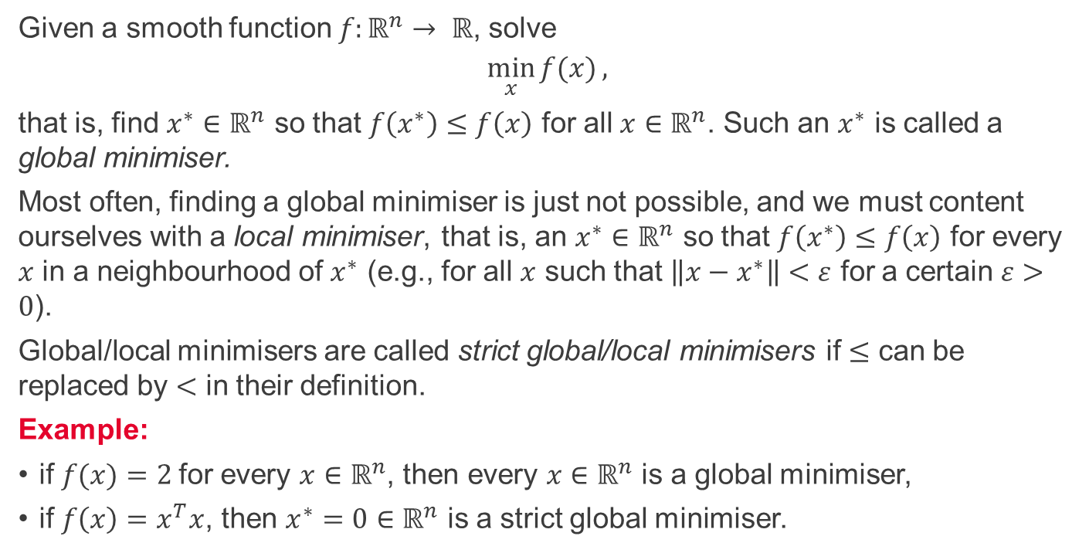
Global and local minimisers
Given a smooth function $f:ℝ^{n}→ ℝ$, solve
$$\min_{x}{f(x)},$$
that is, find $x^{∗}∈ℝ^{n}$ so that $f\left(x^{∗}\right)≤f\left(x\right)$ for all $x∈ℝ^{n}$. Such an $x^{∗}$ is called a global minimiser.
Most often, finding a global minimiser is just not possible, and we must content ourselves with a local minimiser, that is, an $x^{∗}∈ℝ^{n}$ so that $f\left(x^{∗}\right)≤f\left(x\right)$ for every $x$ in a neighbourhood of $x^{∗}$ (e.g., for all $x$ such that $\left\|x−x^{∗}\right\|<ε$ for a certain $ε>0$).
Global/local minimisers are called strict global/local minimisers if $≤$ can be replaced by $<$ in their definition.
Example:
if $f(x)=2$for every $x∈ℝ^{n}$, then every $x∈ℝ^{n}$ is a global minimiser,
if $f\left(x\right)=x^{T}x$, then $x^{∗}=0∈ℝ^{n}$ is a strict global minimiser.

Slide 4
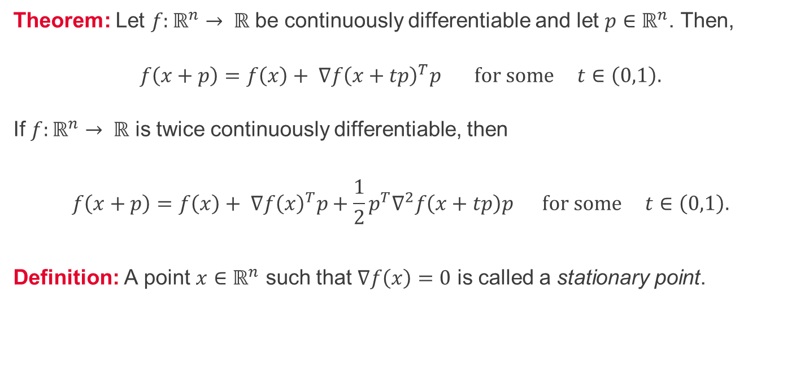
Taylor's theorem
Theorem: Let $f:ℝ^{n}→ ℝ$ be continuously differentiable and let $p∈ℝ^{n}$. Then,
$$f\left(x+p\right)=f\left(x\right)+ ∇f{\left(x+tp\right)}^{T}p \text{for} \text{some} t∈\left(0,1\right).$$
If $f:ℝ^{n}→ ℝ$ is twice continuously differentiable, then
$$f\left(x+p\right)=f\left(x\right)+ ∇f{\left(x\right)}^{T}p+\frac{1}{2}p^{T}∇^{2}f\left(x+tp\right)p \text{for} \text{some} t∈\left(0,1\right).$$
Definition: A point $x∈ℝ^{n}$ such that $∇f\left(x\right)=0$ is called a stationary point.

Slide 5
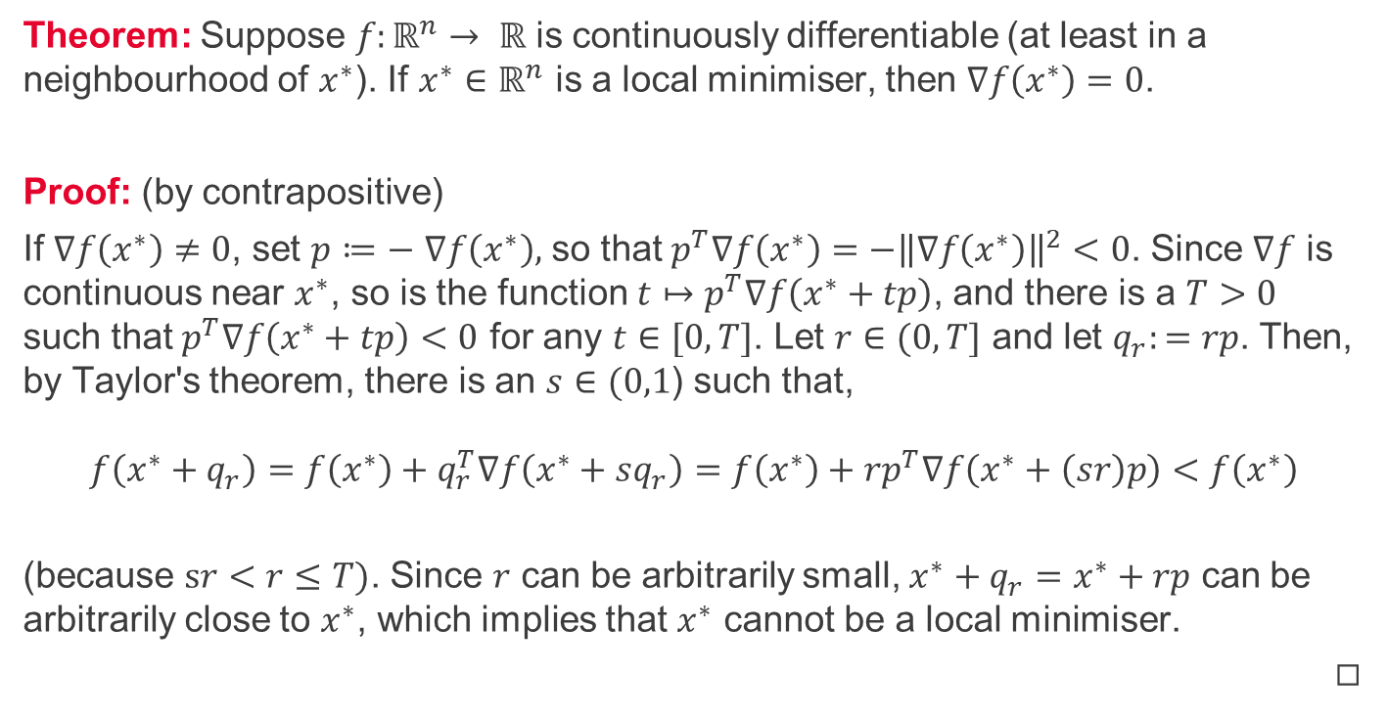
First-order necessary conditions
Theorem: Suppose $f:ℝ^{n}→ ℝ$ is continuously differentiable (at least in a neighbourhood of $x^{∗}$). If $x^{∗}∈ℝ^{n}$ is a local minimiser, then $∇f\left(x^{∗}\right)=0$.
Proof: (by contrapositive)
If $∇f\left(x^{∗}\right)≠0$, set $p≔−$ $∇f\left(x^{∗}\right),$ so that$p^{T}∇f\left(x^{∗}\right)=−{\left\|∇f\left(x^{∗}\right)\right\|}^{2}<0$. Since $∇f$ is continuous near $x^{∗}$, so is the function $t↦p^{T}∇f\left(x^{∗}+tp\right)$, and there is a $T>0$ such that $p^{T}∇f\left(x^{∗}+tp\right)<0$ for any $t∈[0,T]$. Let $r∈(0,T]$ and let $q_{r}:=rp$. Then, by Taylor's theorem, there is an $s∈(0,1$) such that, $$f\left(x^{∗}+q_{r}\right)=f\left(x^{∗}\right)+q_{r}^{T}∇f\left(x^{∗}+sq_{r}\right)=f\left(x^{∗}\right)+rp^{T}∇f\left(x^{∗}+\left(sr\right)p\right)<f\left(x^{∗}\right)$$
(because $sr<r≤T)$. Since $r$ can be arbitrarily small, $x^{∗}+q_{r}=x^{∗}+rp$ can be arbitrarily close to $x^{∗}$, which implies that $x^{∗}$ cannot be a local minimiser.
◻︎

Slide 6
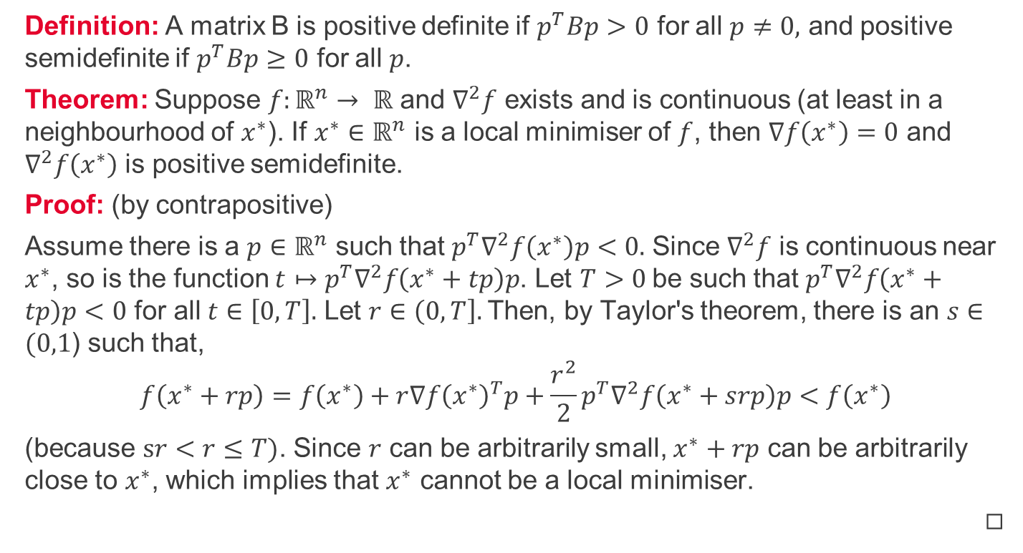
Second-order necessary conditions
Definition: A matrix B is positive definite if $p^{T}Bp>0$ for all $p≠0,$ and positive semidefinite if $p^{T}Bp≥0$ for all $p$.
Theorem: Suppose $f:ℝ^{n}→ ℝ$ and $∇^{2}f$ exists and is continuous (at least in a neighbourhood of $x^{∗}$). If $x^{∗}∈ℝ^{n}$ is a local minimiser of $f$, then $∇f\left(x^{∗}\right)=0$ and $∇^{2}f\left(x^{∗}\right)$ is positive semidefinite.
Proof: (by contrapositive)
Assume there is a $p∈ℝ^{n}$ such that $p^{T}∇^{2}f\left(x^{∗}\right)p<0.$ Since $∇^{2}f$ is continuous near $x^{∗}$, so is the function $t↦p^{T}∇^{2}f\left(x^{∗}+tp\right)p$. Let $T>0$be such that $p^{T}∇^{2}f\left(x^{∗}+tp\right)p<0$ for all $t∈\left[0,T\right].$ Let $r∈\left(0,T\right].$Then, by Taylor's theorem, there is an $s∈(0,1$) such that, $$f\left(x^{∗}+rp\right)=f\left(x^{∗}\right)+r∇f{\left(x^{∗}\right)}^{T}p+\frac{r^{2}}{2}p^{T}∇^{2}f\left(x^{∗}+srp\right)p<f\left(x^{∗}\right)$$
(because $sr<r≤T)$. Since $r$ can be arbitrarily small, $x^{∗}+rp$ can be arbitrarily close to $x^{∗}$, which implies that $x^{∗}$ cannot be a local minimiser.
◻︎

Slide 7
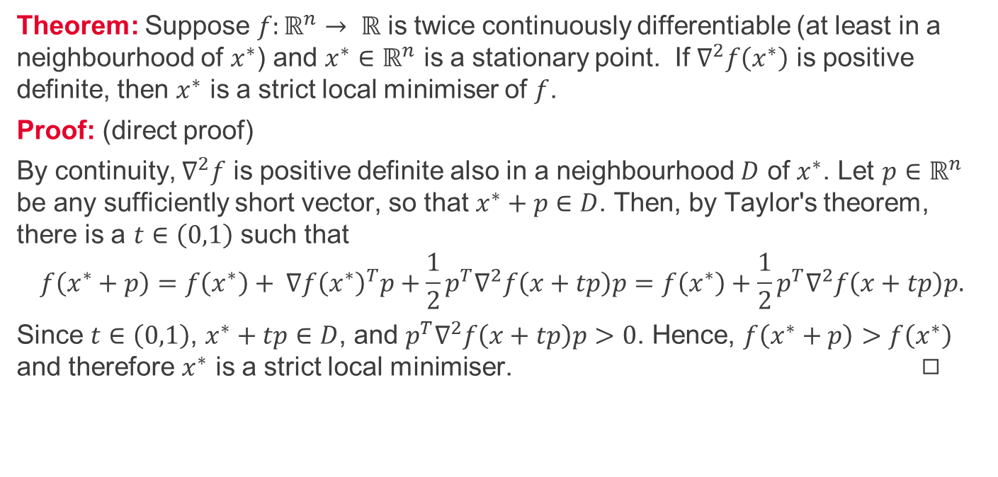
Second-order sufficient conditions
Theorem: Suppose $f:ℝ^{n}→ ℝ$ is twice continuously differentiable (at least in a neighbourhood of $x^{∗}$) and $x^{∗}∈ℝ^{n}$ is a stationary point. If $∇^{2}f\left(x^{∗}\right)$ is positive definite, then $x^{∗}$ is a strict local minimiser of $f$.
Proof: (direct proof)
By continuity, $∇^{2}f$ is positive definite also in a neighbourhood $D$ of $x^{∗}$. Let $p∈ℝ^{n}$ be any sufficiently short vector, so that $x^{∗}+p∈D$. Then, by Taylor's theorem, there is a $t∈\left(0,1\right)$ such that $$f\left(x^{∗}+p\right)=f\left(x^{∗}\right)+ ∇f{\left(x^{∗}\right)}^{T}p+\frac{1}{2}p^{T}∇^{2}f\left(x+tp\right)p=f\left(x^{∗}\right)+\frac{1}{2}p^{T}∇^{2}f\left(x+tp\right)p.$$
Since $t∈\left(0,1\right)$, $x^{∗}+tp∈D$, and $p^{T}∇^{2}f\left(x+tp\right)p>0$. Hence, $f\left(x^{∗}+p\right)>f\left(x^{∗}\right)$ and therefore $x^{∗}$ is a strict local minimiser. ◻︎

Slide 8
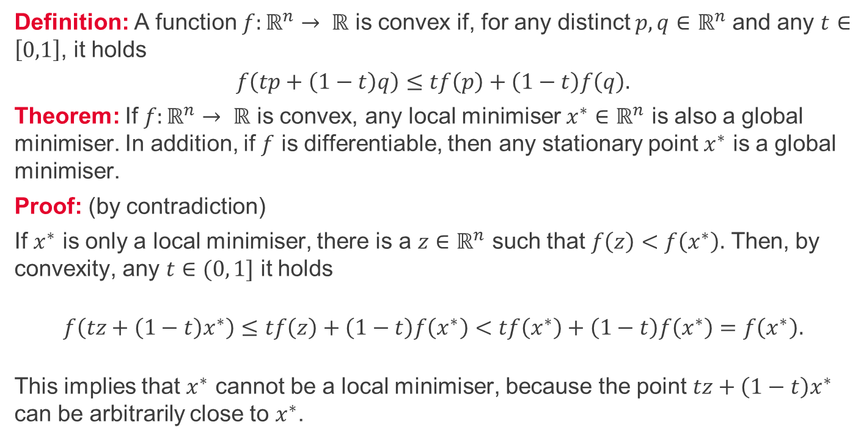
Convex functions 1/2
Definition: A function $f:ℝ^{n}→ ℝ$ is convex if, for any distinct $p,q∈$ $ℝ^{n}$ and any $t∈\left[0,1\right]$, it holds
$$f\left(tp+\left(1−t\right)q\right)≤tf\left(p\right)+\left(1−t\right)f\left(q\right).$$
Theorem: If $f:ℝ^{n}→ ℝ$ is convex, any local minimiser $x^{∗}∈ℝ^{n}$ is also a global minimiser. In addition, if $f$ is differentiable, then any stationary point $x^{∗}$ is a global minimiser.
Proof: (by contradiction)
If $x^{∗}$ is only a local minimiser, there is a $z∈ℝ^{n}$ such that $f\left(z\right)<f\left(x^{∗}\right).$ Then, by convexity, any $t∈(0, 1]$ it holds
$$f\left(tz+\left(1−t\right)x^{∗}\right)≤tf\left(z\right)+\left(1−t\right)f\left(x^{∗}\right)<tf\left(x^{∗}\right)+\left(1−t\right)f\left(x^{∗}\right)=f\left(x^{∗}\right).$$
This implies that $x^{∗}$ cannot be a local minimiser, because the point $tz+\left(1−t\right)x^{∗}$ can be arbitrarily close to $x^{∗}$.

Slide 9
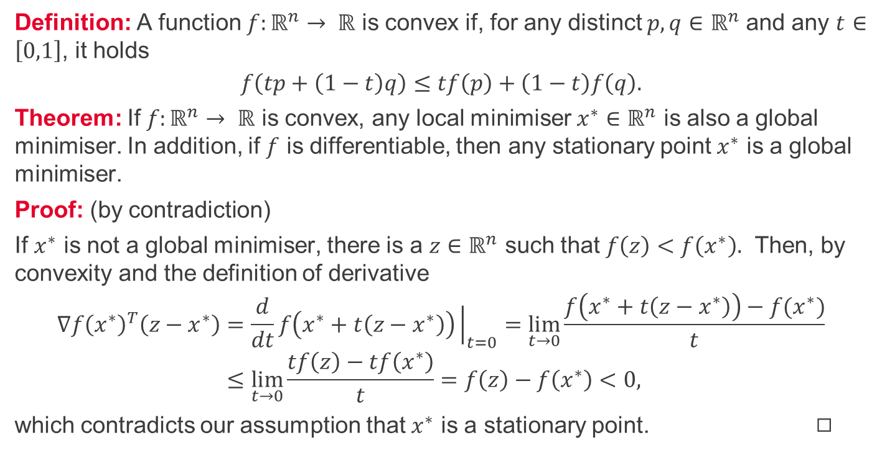
Convex functions 2/2
Definition: A function $f:ℝ^{n}→ ℝ$ is convex if, for any distinct $p,q∈$ $ℝ^{n}$ and any $t∈\left[0,1\right]$, it holds
$$f\left(tp+\left(1−t\right)q\right)≤tf\left(p\right)+\left(1−t\right)f\left(q\right).$$
Theorem: If $f:ℝ^{n}→ ℝ$ is convex, any local minimiser $x^{∗}∈ℝ^{n}$ is also a global minimiser. In addition, if $f$ is differentiable, then any stationary point $x^{∗}$ is a global minimiser.
Proof: (by contradiction)
If $x^{∗}$ is not a global minimiser, there is a $z∈ℝ^{n}$ such that $f\left(z\right)<f\left(x^{∗}\right).$ Then, by convexity and the definition of derivative
$$∇f{\left(x^{∗}\right)}^{T}\left(z−x^{∗}\right)=\frac{d}{dt}f\left(x^{∗}+t\left(z−x^{∗}\right)\right){\left.​\right|}_{t=0}=\lim_{t→0}{\frac{f\left(x^{∗}+t\left(z−x^{∗}\right)\right)−f(x^{∗})}{t}} \\ ≤\lim_{t→0}{\frac{tf\left(z\right)−tf\left(x^{∗}\right)}{t}}=f\left(z\right)−f\left(x^{∗}\right)<0,$$
which contradicts our assumption that $x^{∗}$ is a stationary point. ◻︎

Slide 10
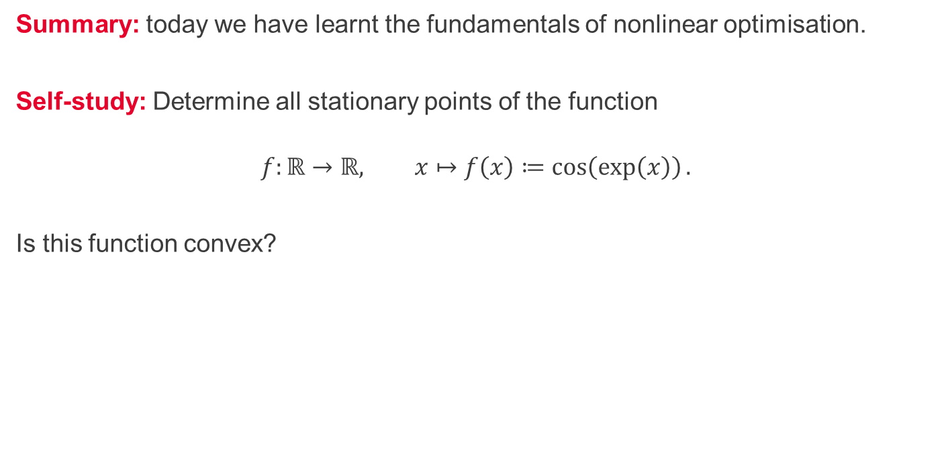
Summary and self-study
Summary: today we have learnt the fundamentals of nonlinear optimisation.
Self-study: Determine all stationary points of the function
$$f:ℝ→ℝ, x↦f\left(x\right)≔\cos\left(\exp\left(x\right)\right).$$
Is this function convex?

